Slide 1
Lesson Planning and Delivery with Notebook Software
What Is Notebook Software?
Notebook™ software is SMART’s whiteboarding software. It acts as an electronic notebook to immediately capture and save notes and drawings written on the SMART Board or at your desktop computer. You can import graphics, text and multimedia elements into your Notebook file or export your Notebook file to HTML, PDF, and PowerPoint or as a series of images.
Preparing Your Lesson
You will prepare a geography lesson activity that asks students to match Caribbean countries to their flags. You can use the concepts outlined in this Hands-On Practice to prepare and deliver lessons in other subject areas.

Slide 2

1. Open a blank Notebook file

Slide 3
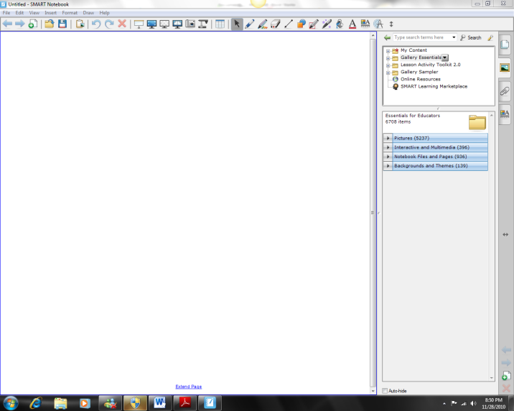
2. Browse the collection of SMART’s custom pages, clip art, flash animations and video files by clicking “Gallery” tab on the right-hand side of the Notebook interface For this Example, you search for flags of Caribbean Countries

Slide 4
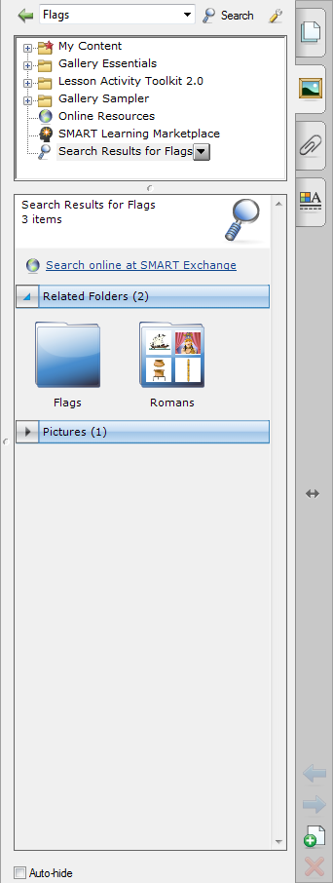
3.Press the button on pen tray to launch the On-Screen Keyboard.
Type the keyword flags and press the Search button to initiate your searchThe flags folder will be displayed on the right side of your screen
4. Notebook software displays your search result(s) as a thumbnail image matching your search criteria. In this example, a folder named Flags will appear.Doublepress the folder thumbnail to view its contents

Slide 5
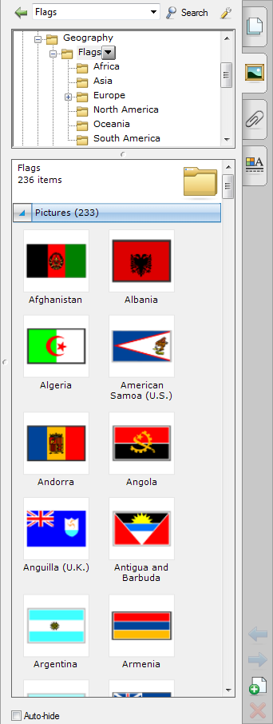
5. Scroll through the Gallery collection to find flags for the Jamaica, Barbados, Haiti and Drag each flag to the work area of your Notebook file.

Slide 6
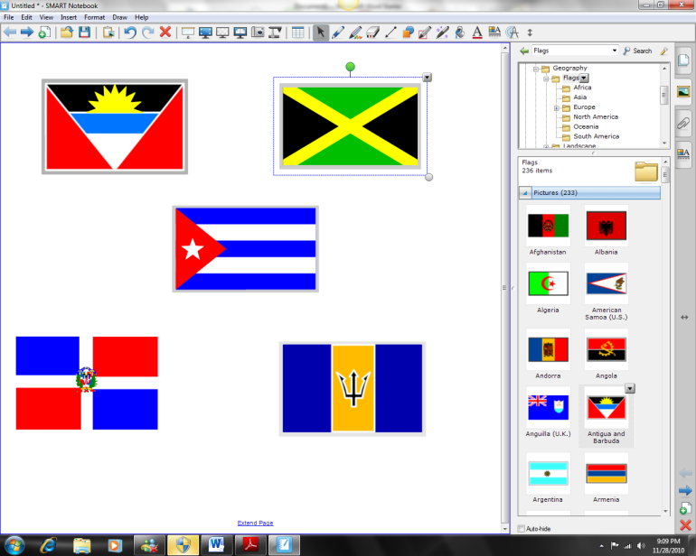
6. Resize each flag by diagonally dragging the resize handle. Ensure the flags are approximately the same size.

Slide 7
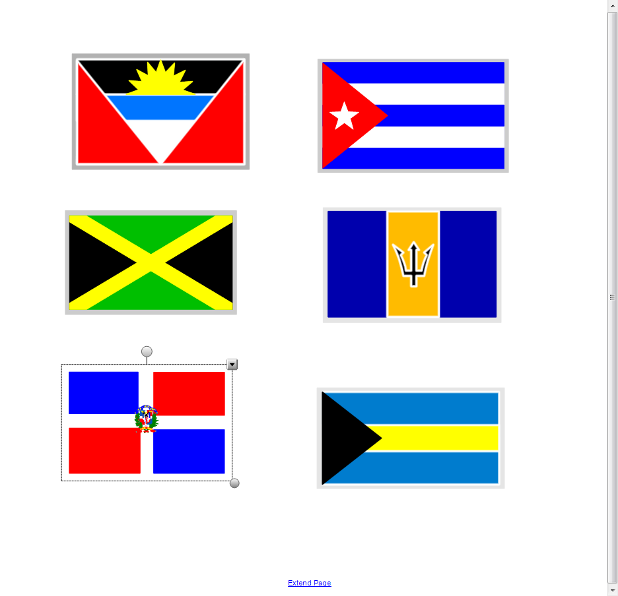
7. Align the flags in two columns horizontally

Slide 8
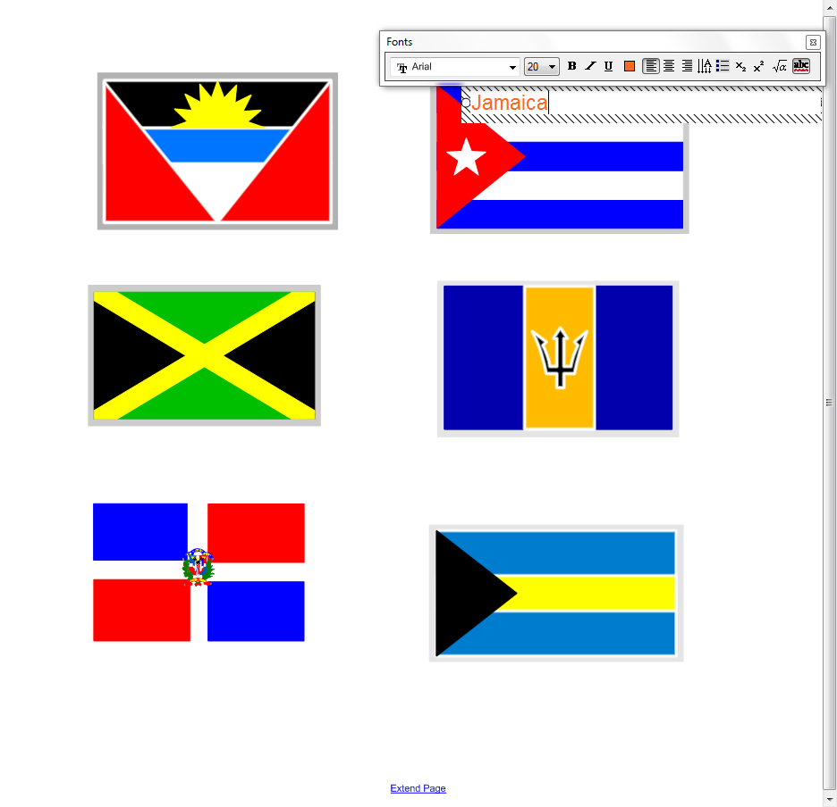
8. Select text box option from the tools bar and choose the appropriate font and color from the text box options. Type in the name of all the countries in a separate text box.

Slide 9
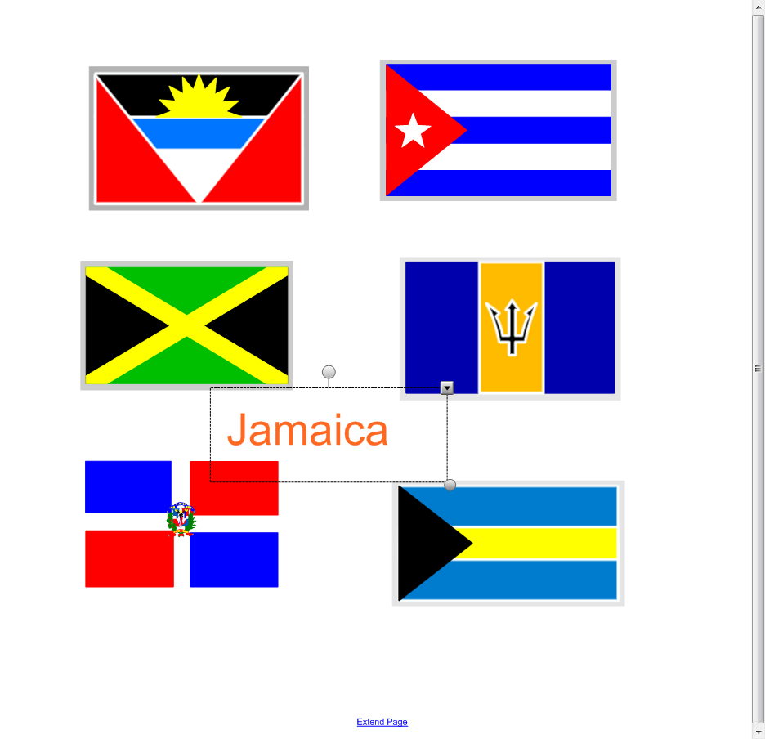
9. Write the name of each country in a different color

Slide 10
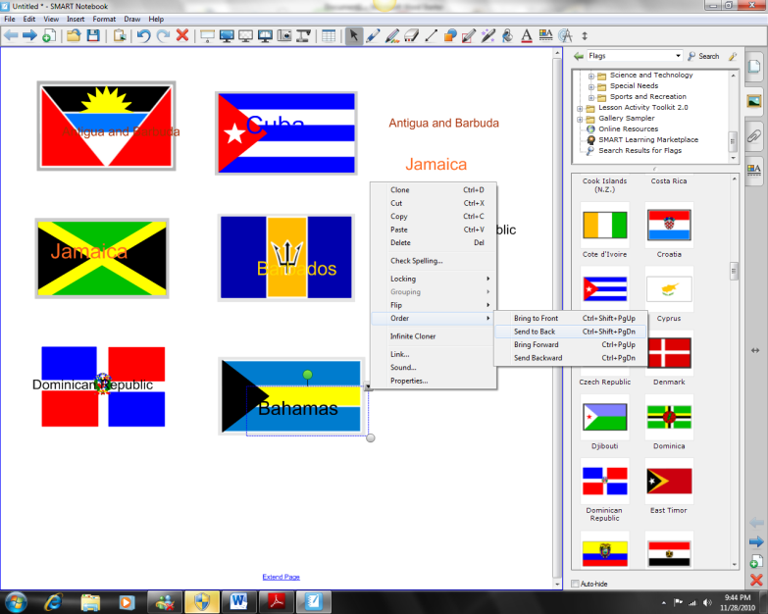
10. Select Clone from the object’s drop-down menu to make a copy of the name of each country. There should be two country names for each flag.

Slide 11
12. Select the Bahamas flag, for example, and choose Order > Bring to Front from the object’s dropdown menu to cover the name of the Bahamas. Complete this task for the other countries Canadian flags.

Slide 12
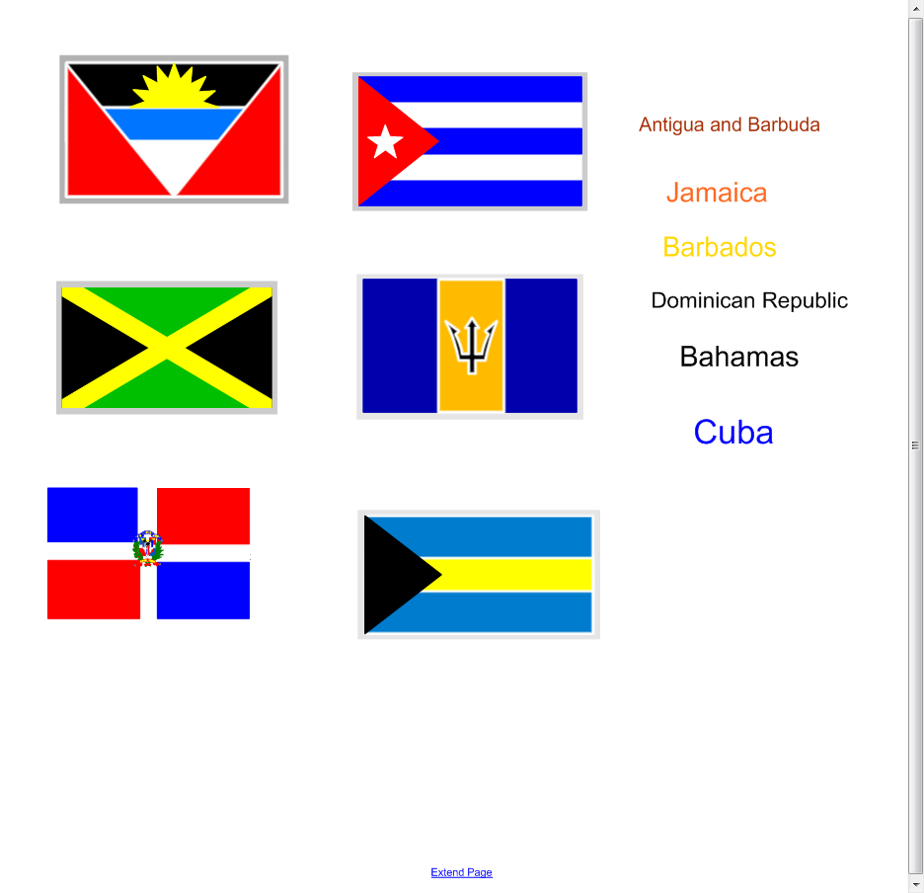
11. Organize the names of each country so that one set of country names is placed in a vertical line on your work area. Drag the other country names over their corresponding flag.

Slide 13
Press File > Save to save your Notebook file. Give your Notebook file a name and choose the location where you want to save it.

Slide 14
After opening your saved Notebook file on the SMART Board interactive whiteboard, ask your students to drag the name of each country underneath its corresponding flag. Once the exercise is completed, remove the flags to reveal the correct answers.

Slide 15
There are many ways that teachers can use the Smart Notebook Software to plan and implement lessons. Please see examples of completed activities in the resources section of this website

Slide 16
End

